Slide 1

1920
Practical Steps Securing your AWS Deployments
Avishay Bar,
Security Architect, CyberArk
December 2020

Slide 2


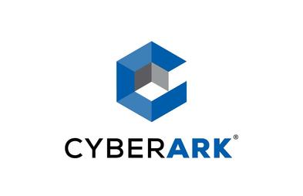




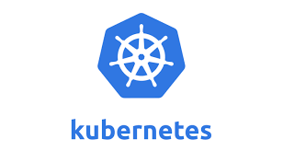
SaaS
App Security
ABOUT ME
Service Security
GitOps
avishay.bar@cyberark.com
Twitter: @avishayil
LinkedIn: avishaybar
אשתי ☹

Slide 3
Cloud Security 2020 Recap – Incidents
Identifying Cloud Misconfigurations Across the SDLC
Examples of insecure defaults
Key Findings & Recap
AGENDA

Slide 4
WHAT’S IN IT FOR YOU
Helping you increase awareness to cloud misconfigurations
Providing you with practical tools to identify them during the software development lifecycle
Share some stuff based on my personal experience

Slide 5

BACKGROUND

Slide 6
TOP 3 CLOUD SECURITY THREATS
Security misconfiguration of production environments (67%)
Lack of visibility into access in production environments (64%)
Improper IAM and permission configurations (61%)

Slide 7

CLOUD SECURITY 2020 INCIDENTS
Capital One
ModSecurity Web Application Firewall allowed Server-Side Request Forgery, overprovisioned EC2 and S3 roles for WAF and storage
* In 2019 there were 45% less incidents related to S3 than in 2018

Slide 8

CLOUD SECURITY 2020 INCIDENTS
Dow Jones
Data was stored in an AWS Elasticsearch database without password protection, i.e. no IAM controls were used.
* Elasticsearch data leakage: 20% of all incidents, 44% of all information volume

Slide 9

CLOUD SECURITY 2020 INCIDENTS
Imperva
Compromise of a cloud server led to unauthorized use of an administrative API key in one of the production AWS accounts.

Slide 10

CLOUD SECURITY 2020 INCIDENTS
Tesco
A third-party service provider stored customer license plate images in a public cloud storage platform without any authentication.

Slide 11
SDLC OVERVIEW

Slide 12
EXAMPLE FEATURE
We have a single user, CRUD based TODO application
We want to use a data store to store each user tasks
We have a requirement that a user should not access other user’s tasks

Slide 13
CLOUD SDLC OVERVIEW
Design/Plan
Development
Testing
Integration
Deployment
Production
Blue / Green Deployment PT
Unit tests Dependencies
Threat Model
IaC Analysis SCA
Integration tests
Security Monitoring

Slide 14
DESIGN / PLAN
Feature Overview – Identify assets, find data stores and risky points
Threat Model – Brainstorm to find the “low hanging fruits” when the architecture is at a “stable” state
Identify if cross-account access / external integrations are needed, and secure those perimeters while keeping the Zero Trust principle

Slide 15
ARCHITECTURE V2

Slide 16
CLOUD SDLC OVERVIEW
Design/Plan
Development
Testing
Integration
Deployment
Production
Blue / Green Deployment PT
Unit tests Dependencies
Threat Model
IaC Analysis SCA
Integration tests
Security Monitoring

Slide 17
DEVELOPMENT
It’s time for automatic tools – IAC Analysis, SAST
Secure code review – Hard to follow but might be useful at some points
Enforce usage of centralize controls and libraries – especially with logic that handles encryption, authentication, authorization

Slide 18
DEVELOPMENT
Don’t re-invent the wheel – use AWS SDK libraries whether you can
Insist on using both IAM policies and resource-based policies, whether possible
Dependencies scanning – Checking the security risks of open-source libraries (sooner is better)

Slide 19
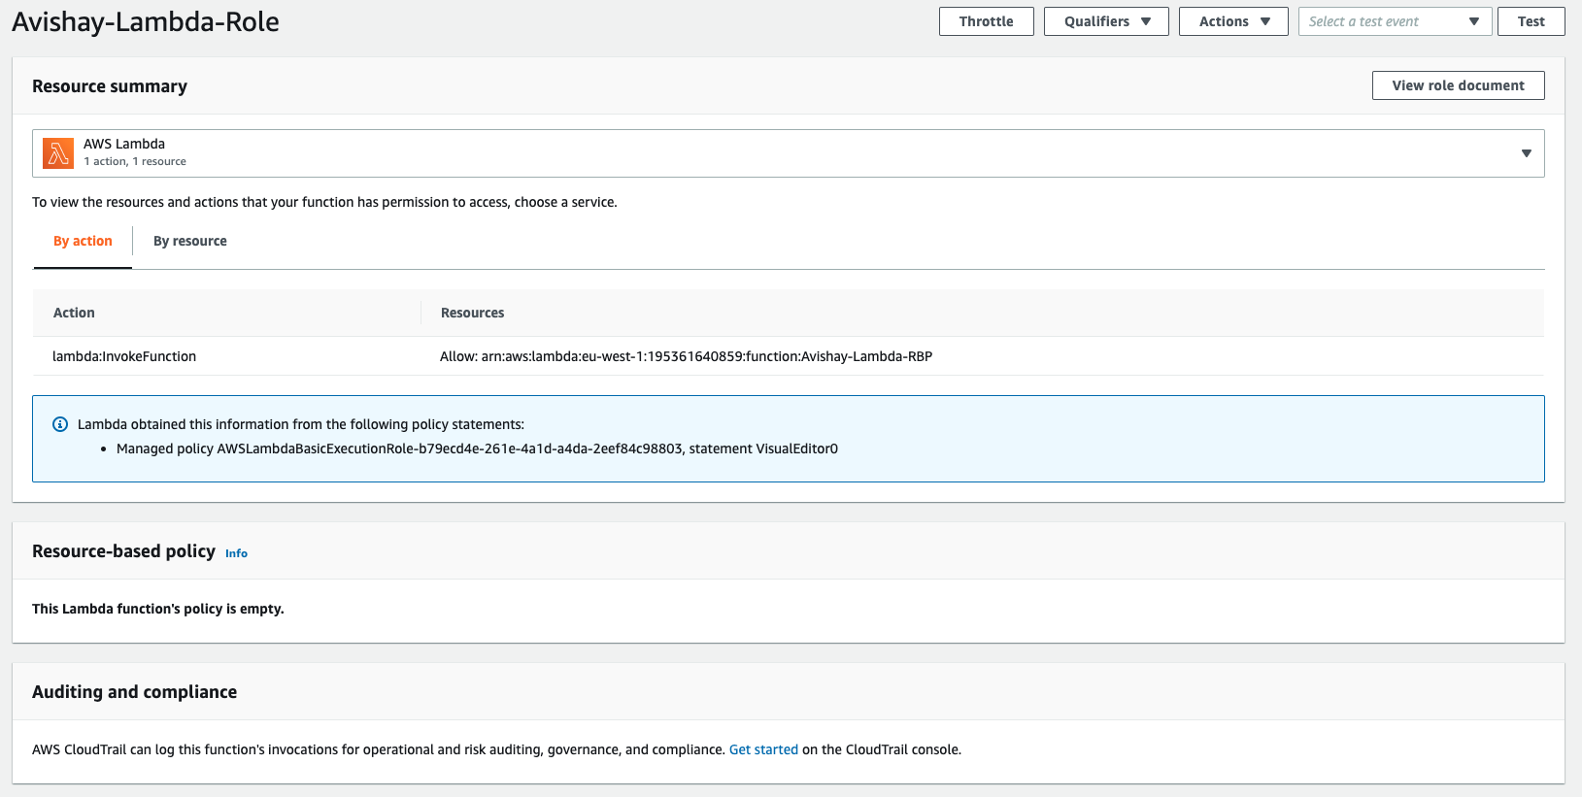
DEVELOPMENT

Slide 20
DEVELOPMENT

Slide 21
DEVELOPMENT

Slide 22
DEVELOPMENT

Slide 23
IAC Analysis
cfn-nag
Rules are written in Ruby
Supports profiles (checks consolidation)
Supports global blacklist

Slide 24
IAC Analysis
checkov
Rules are written in Python
Supports CloudFormation, Terraform, Kubernetes, Serverless, ARM Templates
Link to remediation guide (Optional)

Slide 25
IAC Analysis
cfn-guard
Rules are written in DSL
Easy to use both for common baseline and writing custom rules per project
Rules generator from existing CloudFormation templates

Slide 26
CLOUD SDLC OVERVIEW
Design/Plan
Development
Testing
Integration
Deployment
Production
Blue / Green Deployment PT
Unit tests Dependencies
Threat Model
IaC Analysis SCA
Integration tests
Security Monitoring

Slide 27
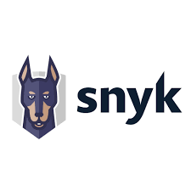


TESTING & INTEGRATION
Unit testing – Test that authenticated request with a user ID different from the user ID in the security context – fails.
Dependencies scanning – Tools like Dependency Check, dependabot, Snyk could run either on the developer machine or at the pipeline

Slide 28
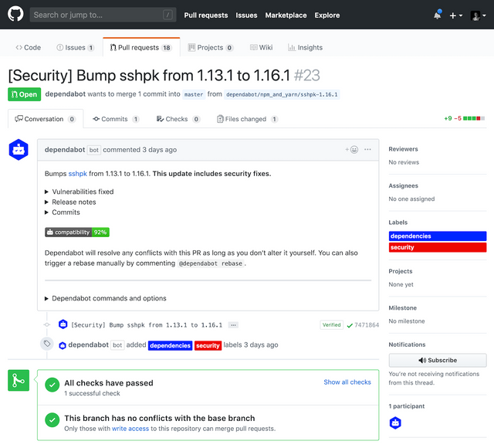
TESTING & INTEGRATION

Slide 29
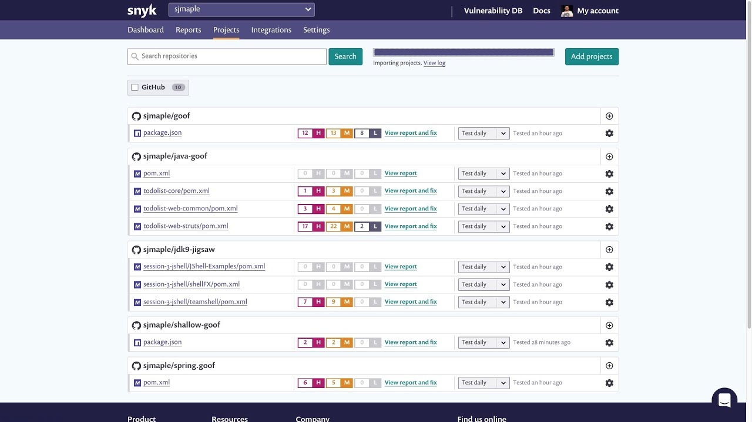
TESTING & INTEGRATION

Slide 30
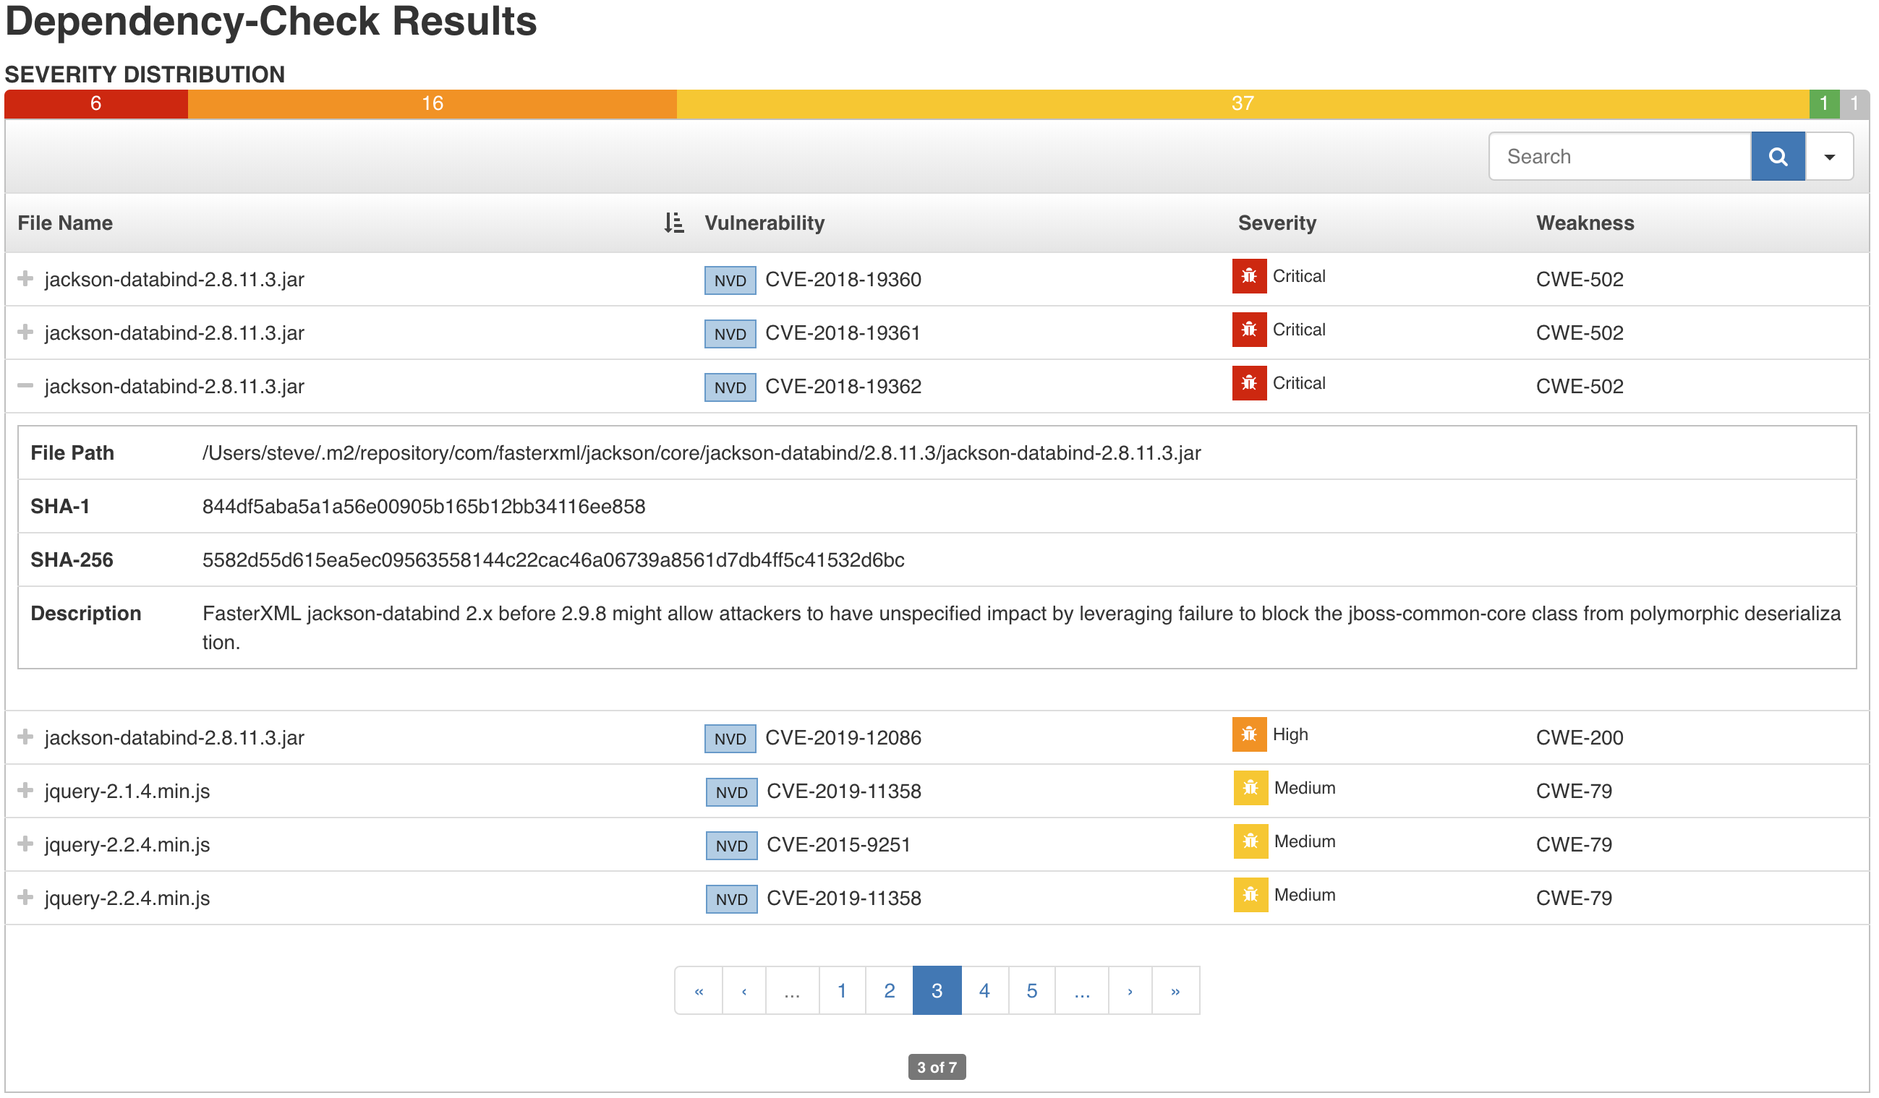
TESTING & INTEGRATION

Slide 31
CLOUD SDLC OVERVIEW
Design/Plan
Development
Testing
Integration
Deployment
Production
Blue / Green Deployment PT
Unit tests Dependencies
Threat Model
IaC Analysis SCA
Integration tests
Security Monitoring

Slide 32
DEPLOYMENT
Blue / Green deployment
Penetration testing
Define a security baseline for all your AWS accounts – Cloud Custodian
AWS Account assessment – Cloud Mapper

Slide 33
CLOUD SDLC OVERVIEW
Design/Plan
Development
Testing
Integration
Deployment
Production
Blue / Green Deployment PT
Unit tests Dependencies
Threat Model
IaC Analysis SCA
Integration tests
Security Monitoring

Slide 34
INSECURE DEFAULTS

Slide 35
INSECURE DEFAULTS
Demo: Console EC2 Provisioning

Slide 36
INSECURE DEFAULTS

Slide 37
INSECURE DEFAULTS

Slide 38
INSECURE DEFAULTS

Slide 39
INSECURE DEFAULTS

Slide 40
INSECURE DEFAULTS

Slide 41
TAKEAWAYS

Slide 42
KEY TAKEAWAYS
Threat model architectures and data flows to understand & prioritize risks
Be aware of potential misconfiguration / sensitive areas on your architecture
Secure code review highlighting policies & permissions review for each task (less scalable)

Slide 43
KEY TAKEAWAYS
Knowledge - Subscribe to your cloud provider RSS feeds / features blog and keep updated on latest security trends, vulnerabilities and incidents
Read about available security controls for each service you deploy / use and raise flags during all the SDLC stages
Use automatic tools & assessment products on IDE & pipeline to detect, alert & fail builds on critical misconfigurations according to a security baseline (more scalable)

Slide 44

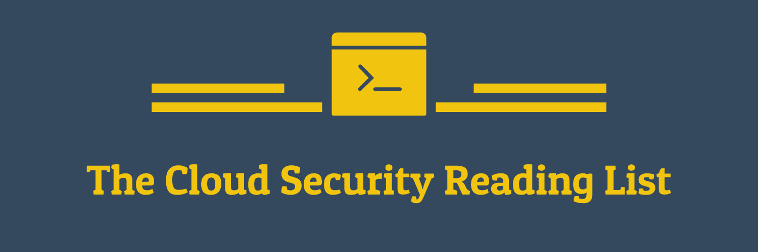
KEY TAKEAWAYS

Slide 45


THANK YOU
QUESTIONS?

